Slide 1



SMART MOBILITY

Slide 2


PROJECT MEMBERS
Karthik Noone
Naga Sateesh Reddy Dantla
Narayan Reddy Dodla
Niharica Myla
Ravichandrika Annadanam
Ruthvik Bhairav Yalavarthi
Sai Chandhar Reddy Thodati
Satheesh Eppalapelli
Sidhartha Annamaneni
Vijay Kumar Chunchu

Slide 3
CYBER PHYSICAL SYSTEMS
Cyber-Physical Systems (CPS) are integrations of computation, networking, and physical processes. Embedded computers and networks monitor and control the physical processes, with feedback loops where physical processes affect computations and vice versa.
What are examples of cyber-physical systems – Cyber-Physical Systems (CPS) are collections of physical and computer components that are integrated with each other to operate a process safely and efficiently. Examples of CPS include industrial control systems, water systems, robotics systems, smart grid, etc.
CPSs are characterized by integration, across technologies, industrial domains, and the life-cycle, and by “smartness.” CPS can be described using a corresponding set of characteristics: technical emphasis, cross-cutting aspects, level of automation, and life-cycle integration.

Slide 4
INTRODUCTION
commuting is a part of our daily working life. Where most of us spend our time waiting for transportation. It’s a huge struggle if there’s no minimum transportation that’s being available for the public.
we came up with an idea to makes daily commute stress-free, time-saving, reliable and convenient, by providing One Way Rental service with the all-new keyless bicycles and scooters, where you can pick up and drop the bikes anywhere you need to.
These bikes allows you first and last mile connectivity encouraging public transport which are offered with minimum documentation so that you can have smooth experience.
The drop-off point can be any legal parking spot across the perimeter, which is accessible to the public.
We provide two kind of vehicles bicycles and electric scooter with point-to-point rides and hourly rides.

Slide 5

EXISTING SYSTEM
One and only public transportation available in Maryville.
Provides shuttle services for students of NWMSU from selected spots to different retail stores.

Slide 6

PROBLEM STATEMENT
Existing shuttle services are provided only on particular days and time.
There is a second person interaction for the availability of your ride.
Limited pick up and drop locations.
Limited vehicles designated in SafeRide.

Slide 7
PROPOSED Solution
Giving commuters time-saving, reliable and convenient rides.
The drop-off point can be any legal parking spot across the perimeter, which is accessible to the public.
Easily accessible (Locate - Authenticate - Ride).
There is no second person interaction to accept your ride.
Increased pickup and drop-off locations.

Slide 8
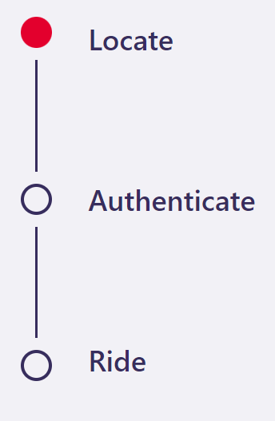



BLOCK DIAGRAM

Slide 9

Thank You

